Slide 1
Max-Min Modularity
Cassandra Spath
Notes:
Title

Slide 2
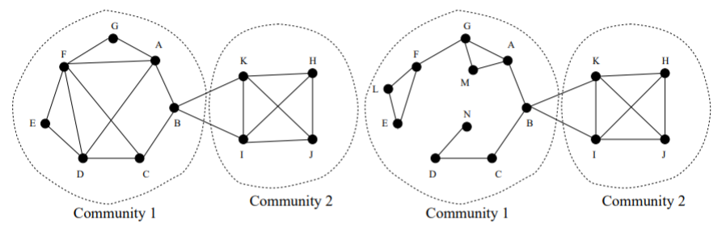
Problems with Modularity
Requires entire graph structure
Fail on small scale communities
Measure existing links only
Notes:
Intro entice

Slide 3
Addressing Problems
Incorporating missing links
Measure structure for existing links
Measure structure for missing links
Notes:
Intro hook

Slide 4
Outline
Max-Min Modularity
Defining related pairs
Results
Karate Club
Sawmill Strike
Mexican Politicians
Structurally
Metadata
Notes:
Outline

Slide 5
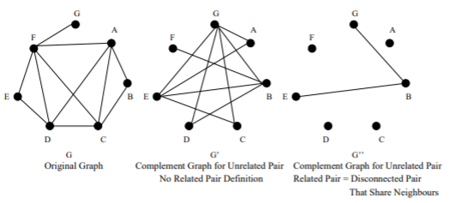
Max-Min Modularity
Maximize modularity
Minimize compliment modularity
Uses compliment graph
Based on related and unrelated pairs

Slide 6
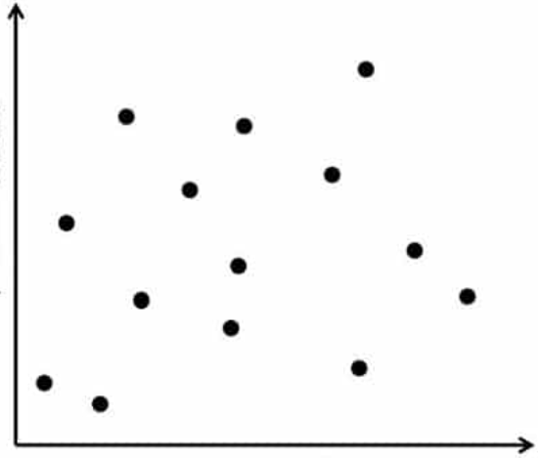
Related Pairs
Metadata Graph
community 2
How to define?
Structurally
Metadata
Time in Network
community 1
community 3
1
2
3
Degree

Slide 7
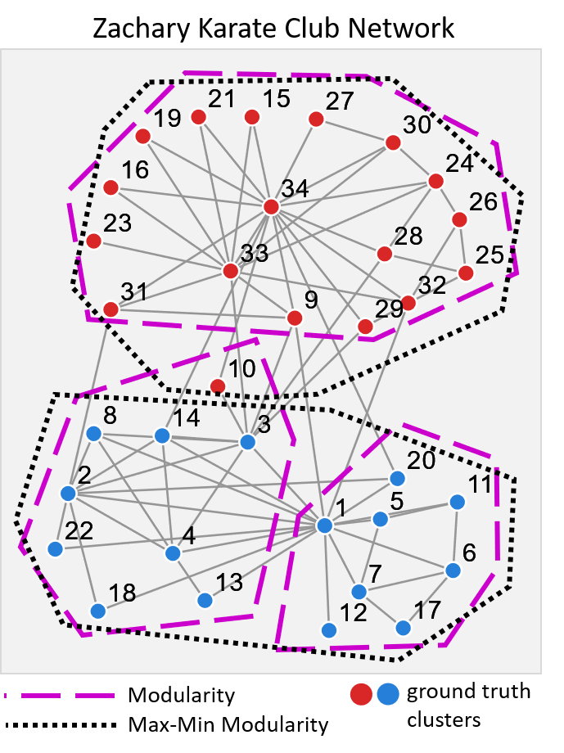
Results on a Simple Network
Straightforward groups
Few connections between communities
Modularity
3 communities
ARI score = 0.680
Max-Min Modularity
2 communities
ARI score = 1.00
Improvement = 47.1%

Slide 8
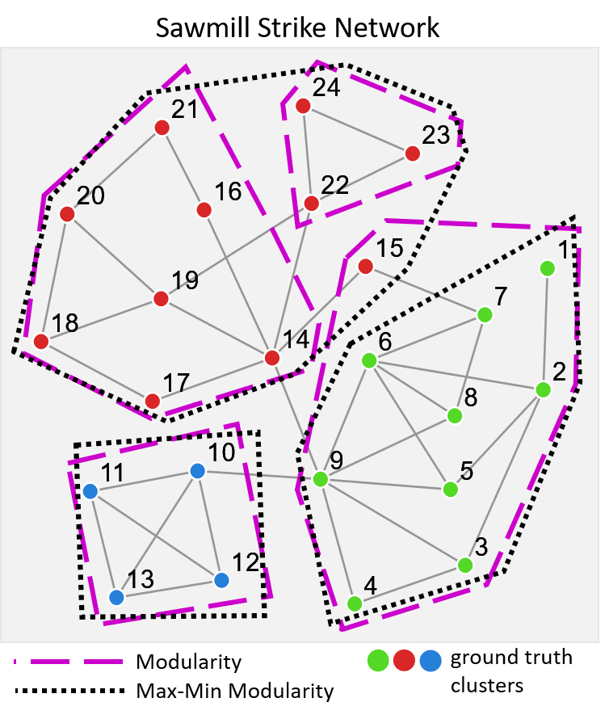
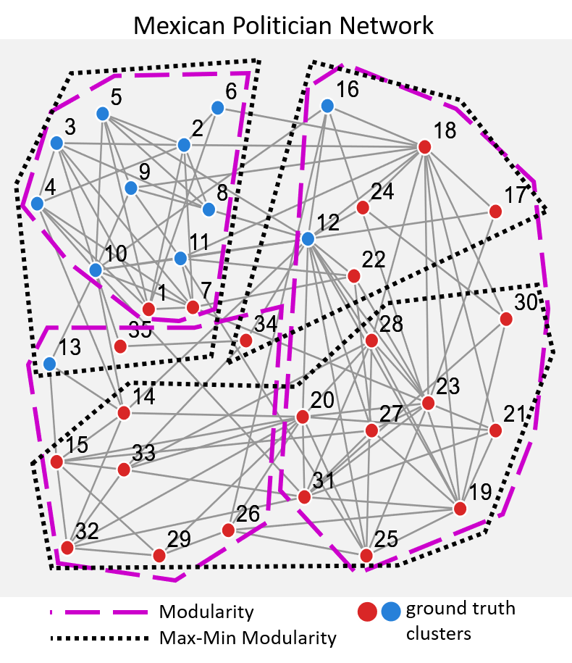
More Results
Sawmill Strikes:
1 less community
ARI score = 1.00
Improvement = 50.6%
Mexican Politics:
ARI score = 0.359
Improvement = 40.7%

Slide 9
Recap
Max-Min Modularity
Defining related pairs
Results
Karate Club
Sawmill Strike
Mexican Politicians
Structurally
Metadata
Notes:
Outline

Slide 10
Acknowledgements
Chen, Jiyang, Osmar R. Zaïane, and Randy Goebel. "Detecting communities in social networks using max-min modularity." Proceedings of the 2009 SIAM international conference on data mining. Society for Industrial and Applied Mathematics, 2009.
Newman, Mark EJ, and Michelle Girvan. "Finding and evaluating community structure in networks." Physical review E 69.2 (2004): 026113.
Zachary, Wayne W. "An information flow model for conflict and fission in small groups." Journal of anthropological research 33.4 (1977): 452-473.
Michael, Judd H. "Labor dispute reconciliation in a forest products manufacturing facility." Forest products journal 47.11/12 (1997): 41.
Gil-Mendieta, Jorge, and Samuel Schmidt. "The political network in Mexico." Social Networks 18.4 (1996): 355-381.
A. Clauset. “Finding local community structure in networks.” Physical Review E, 72:026132, 2005.
S. Fortunato and M. Barthelemy. “Resolution limit in community detection.” PROC.NATL.ACAD.SCI.USA, 104:36, 2007.
J. Ruan and W. Zhang. Identifying network communities with a high resolution. Physical Review E, 77:016104, 2008
J. Scripps, P.-N. Tan, and A.-H. Esfahanian. Exploration of link structure and community-based node roles in network. In ICDM, 2007
Peel, Leto, Daniel B. Larremore, and Aaron Clauset. "The ground truth about metadata and community detection in networks." Science advances 3.5 (2017): e1602548.
Newman, M., Clauset, A. “Structure and inference in annotated networks.” Nat Commun 7, 11863 (2016) doi:10.1038/ncomms11863
A. Gionis, H. Mannila, and P. Tsaparas. Clustering aggregation. In ICDE, pages 341–352, 2005.
Notes:
Thx & Acknowledgements

